Slide 1
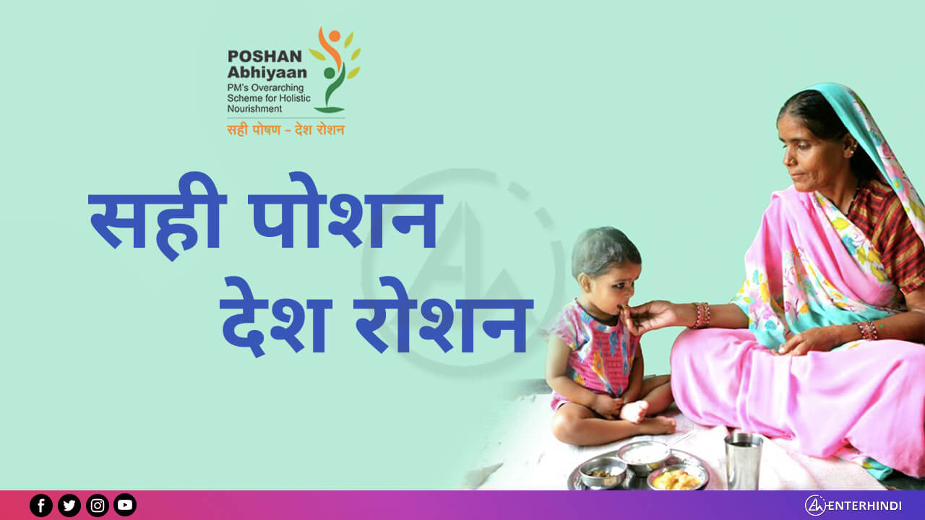
Poshan abhiyaan
PROMOTING HOLISTIC NUTRITION AMONG CHIDREN THROUGH THE HELP OF (IT)FOR POSHANABHIYAAN

Slide 2
ABSTRACT
Proper nutrition is crucial for everybody, but it is especially important for kids and women because inadequate nutrition effects not only on women’s own health but also on the health of their children.
Nutrition is directly linked to their overall growth and development. The right nutrition in the right amount leads to a healthier life as they grow.
Nowadays consumption of extra nutrients has become mandatory to stay healthy and to maintain good immune system.

Slide 3
LITERATURE SURVEY
India has attempted several nutrition programmes over the last 40 years, with the formulation of the Integrated Child Development Services (ICDS).
However, nutrition and stunting continue to persist as roadblocks for the country.
According to the National Family Health Survey 4 (NFHS-4) 2015-16, India has unacceptably high levels of stunting, despite marginal improvement over the years.

Slide 4
Under the ICDS umbrella, multiple schemes such as Anganwadi services, schemes for Adolescent Girls, and Pradhan Mantri Matru Vandana Yojna (PMMVY) have been initiated. Additionally, Nutritional Rehabilitation Centres were established by the Ministry of Health and Family Welfare to treat severe malnutrition in children.
Despite of all programmes and schemes targeting maternal and child health and nutrition, the uptake of nutrition services by beneficiaries has been meagre.
According to the NFHS-4 data, only 51 percent of pregnant women attended the minimum four antenatal services and only 30 percent of women consumed IFA supplements.

Slide 5
With the objective of enhancing inclusion and increasing the quality and quantity of services, the Ministry of Women and Child Development launched the National Nutrition Mission (POSHAN Abhiyaan) in 2017.
The principal goal of POSHAN Abhiyaan is improving the nutritional status of children from 0-6 years, adolescent girls, pregnant women, and lactating mothers.
POSHAN Abhiyaan is a three-year programme established to ensure a holistic approach, covering all 36 States and Union Territories.

Slide 6
OBJECTIVE
Promoting Holistic Nutrition Among Women and children through/with the help of IT for PoshanAbhiyaan. Design a system for health worker to monitor and trigger alarms if some women/child have not come for upcoming dose. Additionally, If the email Id of the patient is registered then provide notification to them to get the dose. .

Slide 7
INTRODUCTION
POSHAN ABHIYAAN:
There are 4-5 crore people in India who are suffering from malnutrition .
So, in order to remove this number by 2025 our government has launched a scheme called “Poshan Abhiyaan” in 2018 with a budget of 9046 crores.
The main aim of this scheme is to reduce 1.stunting
2.under nutrition
3. anaemia
4.Reduce low birth weight.
According to our sustainability development goals , the goal no’s 2 and 3 are “People in India should not die with hunger and everyone should maintain good health.
That is the reason it is vital to maintain the record of the children and women who are suffering with nutritional problem and make them healthier through the scheme , which we can achieve through this website.

Slide 8
EXISTING SYSYTEM
All the applications which are available are only providing the information about dosage and the timing they have to take the dosage, but no application is providing the workers the track record of the customers about their daily consumption and the record of the missing people from the intake.
Above all the existing applications are not providing notification facilities to the people who enrolled and missed the dose.

Slide 9
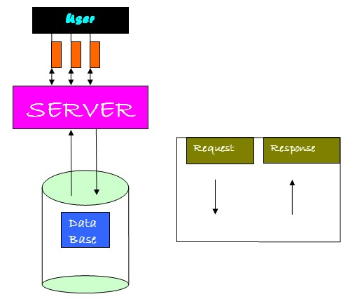
ARCHITECTURE

Slide 10
PROPOSED SYSTEM
We are designing a system for health worker to monitor and trigger alarms if some women/child have not come for upcoming dose. In this case checking the reports and prescriptions of patients regularly to check if they have an appointment is tedious work, instead if we design an automated system and it automatically provide alert to the health workers so that they can communicate the same to the patients.
Additionally, if mobile number of the patient is registered then provide notification to them to get the dose. This can help to promote nutrition among women and children with the help of this device for accomplishing PoshanAbhiyaan.
By creating a web application, we can keep a track of dosage and decrease the rate of malnourishment in women/children.

Slide 11

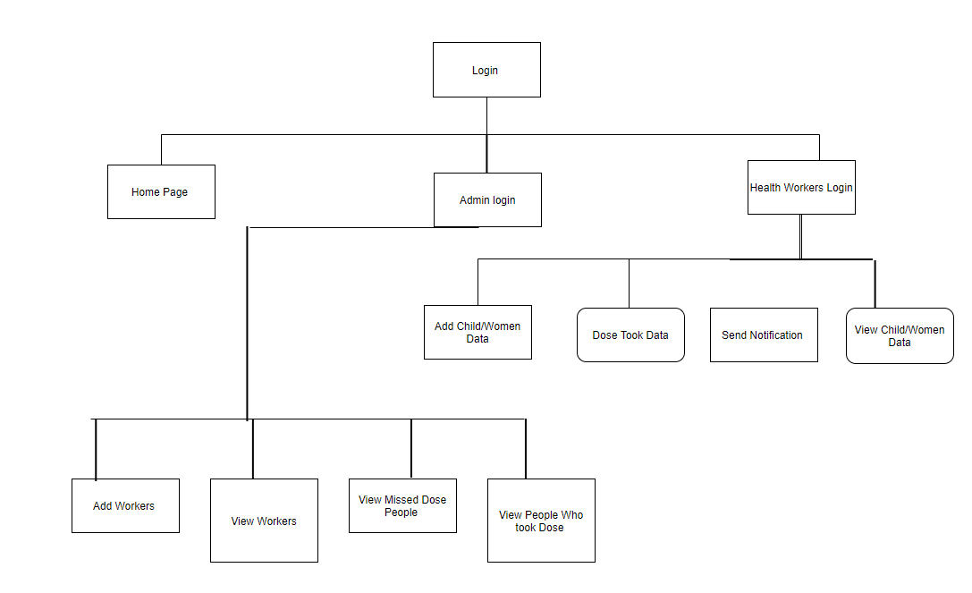
BLOCK DIAGRAM

Slide 12
REQUIREMENT SPECIFICATION
MODULES:
Admin
Worker
Modules Description
This project consists of two modules
Admin Module: using this module admin login to application as super user by using username as ‘admin’ and password as ‘admin’. After login admin will add workers details and provide username and password to workers. Admin can view all peoples who took dose for current month and can view all peoples who missed dose.
Worker Module: workers login to application by taking username and password from admin. After login worker will add women/child details and record dose taking start and end date and assign id to each child/women. After recording details worker will select id if person appear to take dose and dose taking details for current month will be recorded. If any women/child miss does then worker will send notification to them by using ‘Send Notification’ option from application. Here we are sending notification via email as sending SMS require Phone Network Service Providers like AIRTEL and if we want to take that service then we need to pay amount to them so email notification is free so I am using email option.

Slide 13
Algorithm
ADMIN LOGIN
Function admin login(username,password)
{
If (username==admin && password == admin)
Then
Press login button
Else
It is invalid user.
}

Slide 14
ADD DOSE ENTRY
Function doseEntry(worker_id,child_women_id, dose_date)
{
booleanworker_validated = validateWorker(worker_id)
if(worker_validated)
{
booleancheck_child_women_id = isChildWomen_record_exists(child_women_id)
if(check_child_women_id)
{
save_dose_entry_to_database(worker_id,child_women_id, dose_date);
} } }

Slide 15
SEND NOTIFICATION
Function sendNotification(child_women_id, dose_start_date, dose_end_date)
{
Previous_took_date = readDosedate(child_women_id)
current_date = today_date()
if (current_date.after(dose_start_date) &&current_date.before(dose_end_date)
{
thensend_email_notification_to(child_women_id)
}
}

Slide 16
IMPLEMENTATION
In HTML page we will specify name of servlet which process HTML input data by using FORM ACTION Tag. Each text field in the HTML page is associated with unique name and servlet can read input value of that text field by giving its name.
<HTML>
<BODY>
<FORM ACTION=”LOGIN” METHOD=”POST”>
Username <INPUT TYPE=”TEXT” NAME=”t1” SIZE=”25”>
Password <INPUT TYPE=”PASSWORD” NAME=”t2” SIZE=”25”>
<INPUT TYPE=”SUBMIT” VALUE=”Login”>
</FORM></BODY></HTML>

Slide 17
Login.java servlet program
import javax.servlet.*;
import java.io.*;
import javax.servlet.http.*;
public class Login extends HttpServlet
{
public void doPost(HttpServletRequest request, HttpServletResponse response)throws ServletException, IOException
{
String username = request.getParameter ("t1");
String password = request.getParameter ("t2");
if (username.equals("admin") && password.equals("admin"))

Slide 18
{
HttpSession session=request.getSession();
session.setAttribute("user",username);
response.sendRedirect("AdminScreen.jsp?t1=Welcome "+user);
}
else
{
RequestDispatcher rd = request.getRequestDispatcher("AdminLogin.jsp?t1=invalid username or password");
rd.forward(request, response);
}

Slide 19
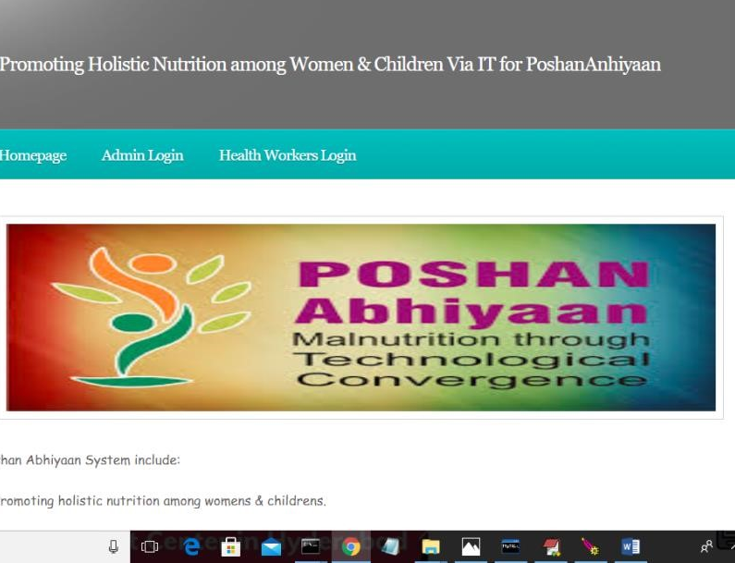
WORKING PROCESS
click on ‘Admin Login’ link to login as admin

Slide 20
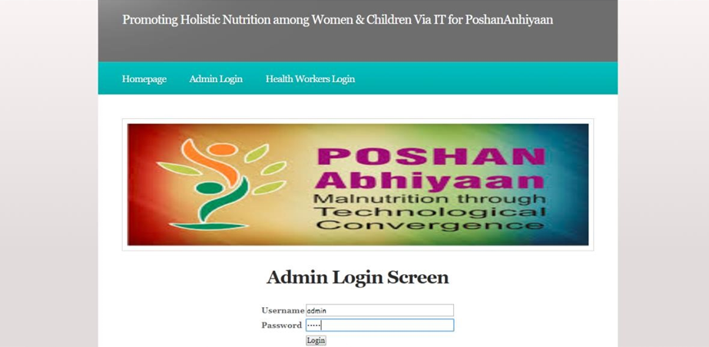
Click on ‘Login’ button to get below screen

Slide 21
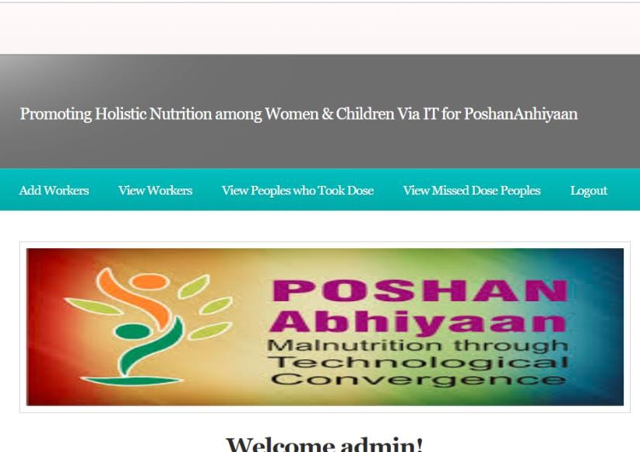
click on ‘Add Workers’ link to add worker details

Slide 22
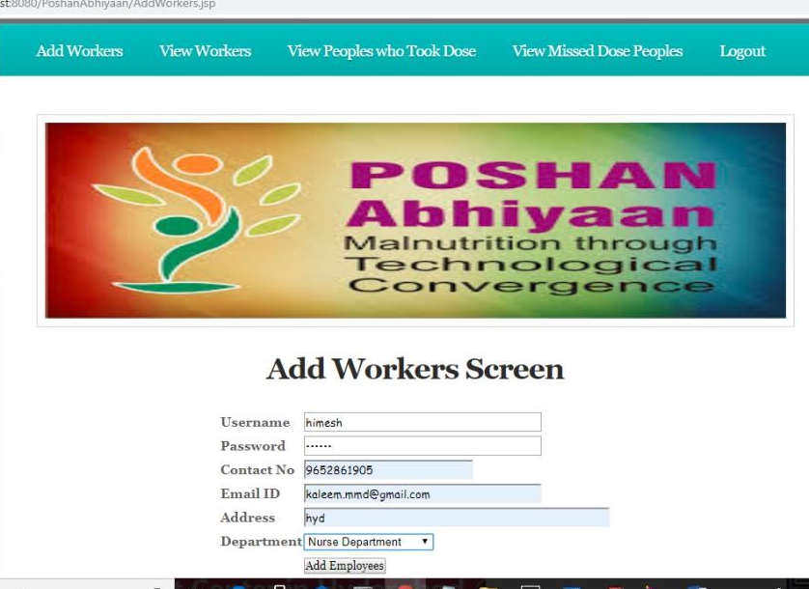
After entering the details click on “Add Employee” Button

Slide 23
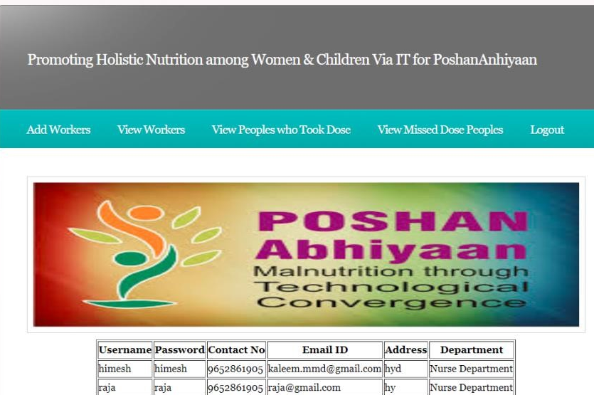
We can view the workers details by clicking on “ View Workers” button.

Slide 24
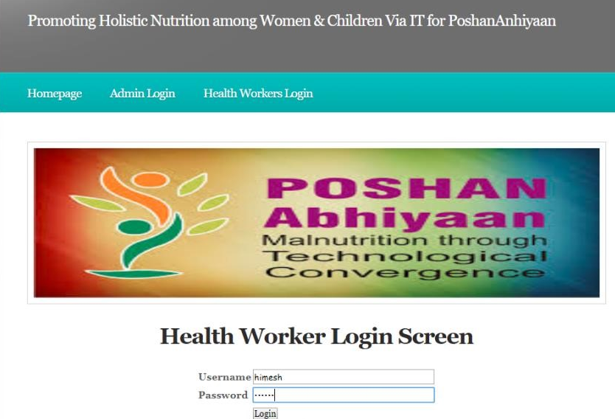
Now login to website as a “health worker” by entering your respective username and password .

Slide 25
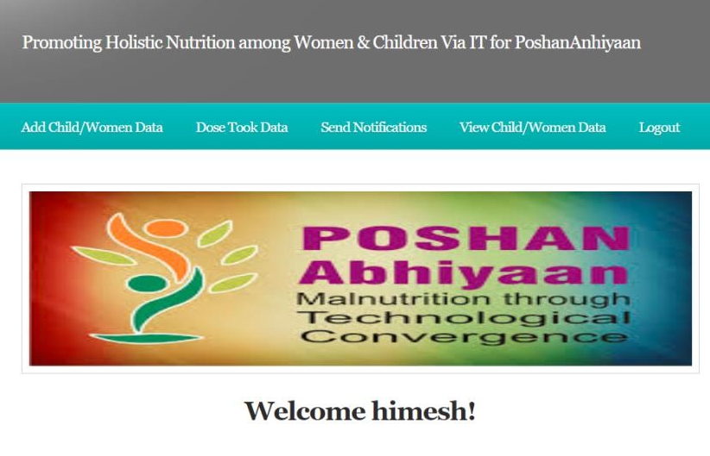
You can add any children or women details who are going to the food.

Slide 26
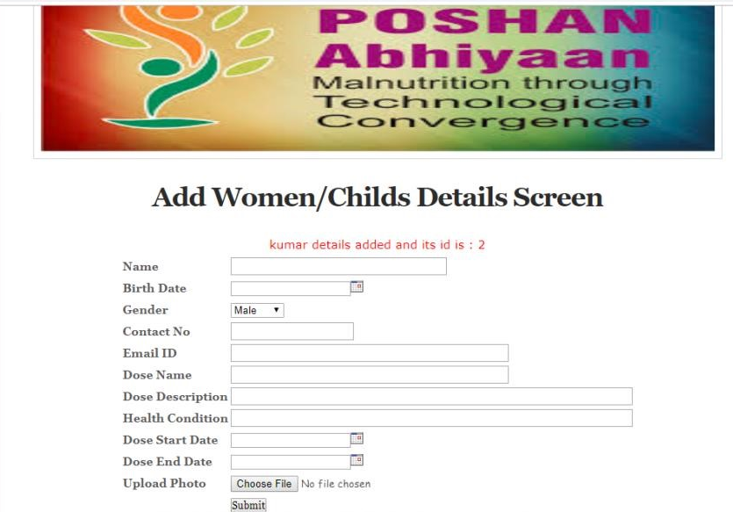
This is the Screen where you can fill the details of the user.

Slide 27
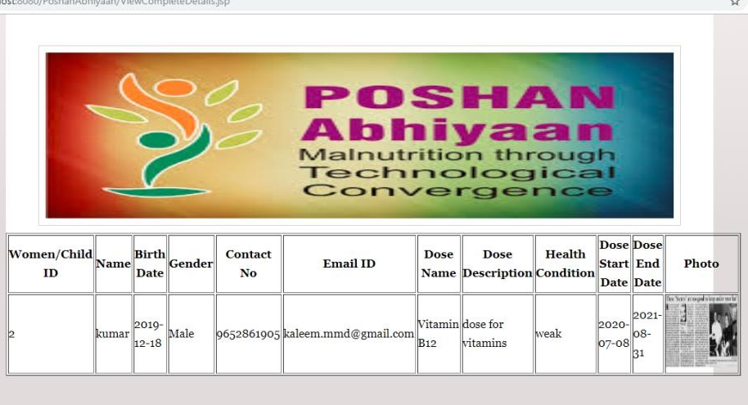
You can view the details of the patients who took the dose and who missed the dose in this format.

Slide 28

We can also send the notifications to the people who missed there dose.

Slide 29
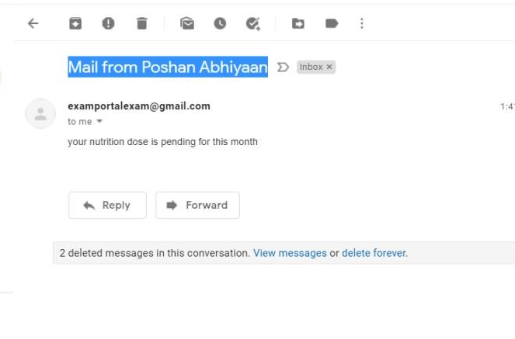
This is how patients are supposed to get their notifications through the mail

Slide 30
Conclusion
We have created a web application for health worker to monitor and trigger alarms if some women/child have not come for upcoming dose.
Along with that we provided a feature and by that we can automatically provide alert to the health workers so that they can communicate the same to the patients and can send notification through the mail id or mobile number.

Slide 31
REFERENCES
https://www.india.gov.in/spotlight/poshan-abhiyaan-pms-overarching-scheme-holistic-nourishment
https://www.orfonline.org/research/towards-a-malnutrition-free-india-63290/
https://niti.gov.in/sites/default/files/2020-10/POSHAN-Abhiyaan-Monitoring-Report22July2020.pdf
http://poshanabhiyaan.gov.in/
https://www.who.int/nutgrowthdb/database/countries/ind/en/
https://globalnutritionreport.org/resources/nutrition-profiles/asia/southern-asia/india/
https://www.youtube.com/watch?v=s3rT81FfmE0

Slide 32
THANK YOU

